Slide 1

Analyzing U.S. Aviation Accidents
INSIGHTS & RECOMMENDATIONS

Slide 2
Project Overview
Goal
Understand trends and risk factors in aviation accidents in the US market to improve safety and inform aircraft operation and acquisition decisions.
Dataset used
Raw Aviation Accident data obtained from a Kaggle dataset.
Tools Used
Python for cleaning my dataset and visualisations and Tableau for visualisation.

Slide 3
Business Understanding
Key Questions:
Where and when are accidents most likely to occur?
What types of aircraft are most involved?
What human or environmental factors increase risk?
Business Objective:
Reduce operational risk and improve fleet safety through data-driven decision-making.

Slide 4

The Data Journey
Loading and Cleaning Raw Data
Conclusion and Recommendations
Exploratory Data Analysis (EDA) and Visualisations
Tableau Visualisation of Cleaned Data

Slide 5
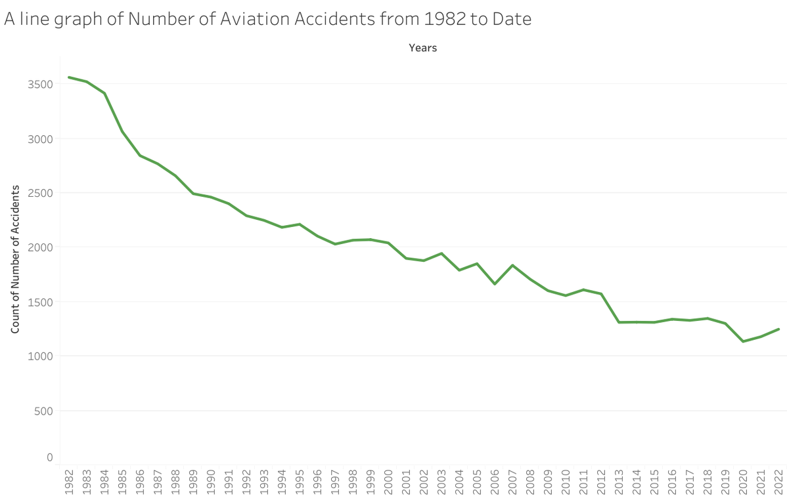
Accident Trends Over Time
General decline in incidents over time suggests improving safety standards, but vigilance still needed.
Recommendation - Continue investing in data-driven safety initiatives to maintain downward trend.

Slide 6
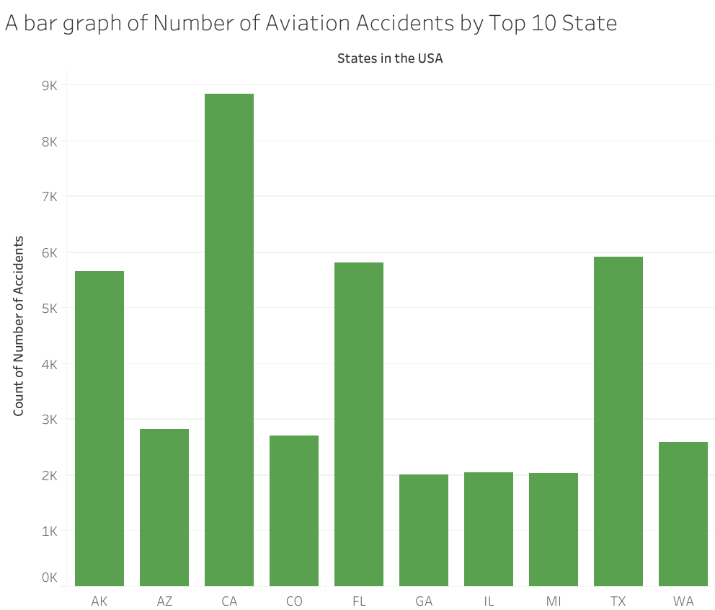
Geographic Hotspots
California, Texas, Florida, and Arizona have the highest accident counts, likely due to high traffic and favorable flying conditions.
Recommendation - Prioritize safety upgrades and inspections in high-volume flying states.

Slide 7
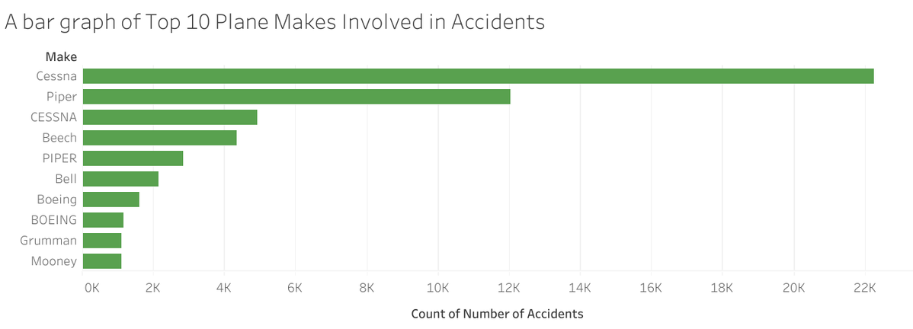
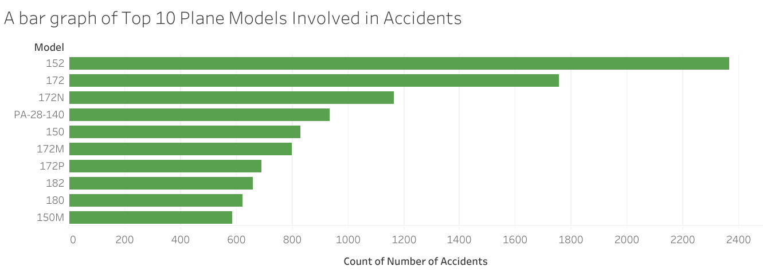
Aircraft Models and Engine Types
Cessna models and single-engine planes are involved in a disproportionate number of accidents.
Recommendation - Evaluate alternative aircraft models and reinforce maintenance and pilot training protocols for existing fleet.

Slide 8
Key Business Recommendations
Sustain Current Safety Gains - Maintain strong oversight, especially in regions with historically high accident rates.
Target High-Risk States for Intervention - Focus pilot training, inspections, and enforcement in California, Texas, Florida, and Arizona.
Reassess Fleet Composition - Consider diversifying away from high-risk models and single-engine planes; reinforce training & maintenance.

Slide 9
Next Steps
Conduct deeper causal analysis (e.g., pilot error vs. mechanical failure)
Overlay with cost data to assess financial impact of each type of accident
Use predictive modeling to flag high-risk flights in advance

Slide 10
Only when the tide goes out do you discover who’s been swimming naked.
Warren Buffett

Slide 11
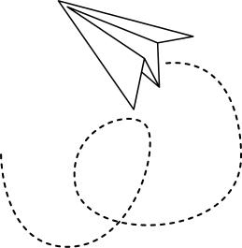
Thank You!
Keith Tongi
keith.tongi@student.moringaschool.com

